Slide 2
Proposed Kentucky Academic Standards for Social Studies
Webcast
May 16, 2019

Slide 3
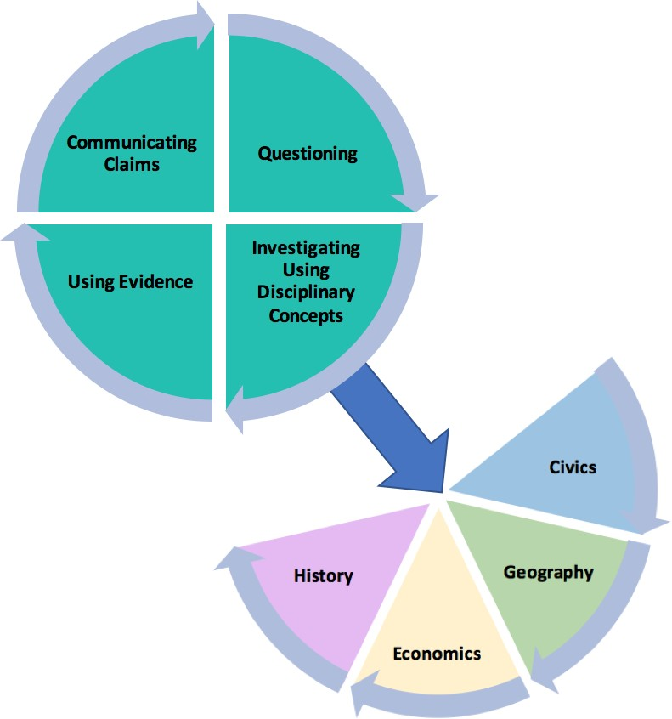
Organization of the Standards
Notes:
Within the architecture, the standards place an equal importance on both the mastery of important social studies concepts and disciplinary practices. Throughout a child’s social studies education, students engage in the inquiry practices – questioning, investigating, using evidence and communicating conclusions. Students use these practices to acquire, refine and extend knowledge and understanding of key social studies concepts within the four disciplinary lenses of civics, economics, geography and history. As indicated by the architecture of the standards, concept knowledge cannot be achieved effectively without the practice of inquiry. Neither development of the practices nor development of the knowledge and understanding within the lenses is sufficient on its own to equip young people with the knowledge and skills necessary to carry on the ideals of the founders.

Slide 4
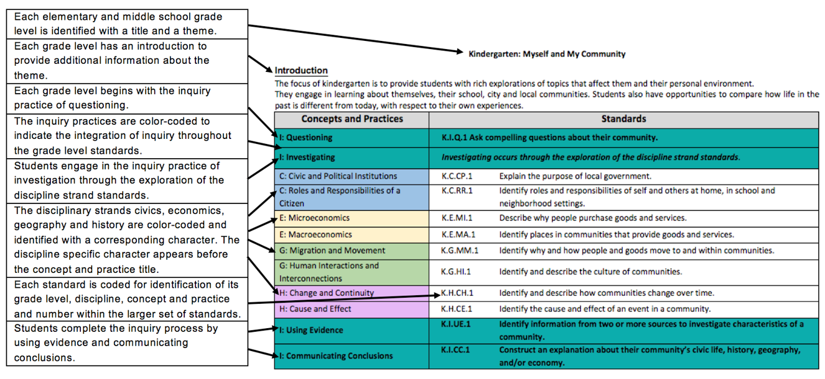
KAS for Social Studies – Standards View
Notes:
When engaging with the KAS for Social Studies, it is important to understand the architecture of the standards. The image shown is an example of how the KAS for Social Studies are organized kindergarten through Grade 8. Each elementary and middle school grade level is identified with a title and a theme. This theme drives the grade level standards, meaning that the standards are connected to the theme. Each grade level has a short introduction to provide additional information about the grade level theme. Each grade level begins with the inquiry practice of questioning. The inquiry practices are color-coded to indicate the integration of inquiry throughout the grade level standards. Students engage in the inquiry practice of investigation through the exploration of the discipline strand standards. The disciplinary strands civics, economics, geography and history are color coded and identified with a corresponding character. The discipline specific character appears before the concept and practice title. Each standard is coded for identification of its grade level, discipline, concept and practice and number within the larger set of standards. Students complete the inquiry process by using evidence and communicating conclusions.
It is important to note that while the standards were just discussed by reading them from right to left and top to bottom, the standards are not meant to be engaged with linearly. Meaning, that a student does not have to start with the questioning standards and the content standards prior to engaging with the using evidence standards as students should be asking questions, using evidence and communicating conclusions throughout their learning.
The KAS for Social Studies for high school is organized within a similar architecture but the high school standards are organized around the disciplines of civics, economics, geography and US and World History rather than being organized around a theme.

Slide 5
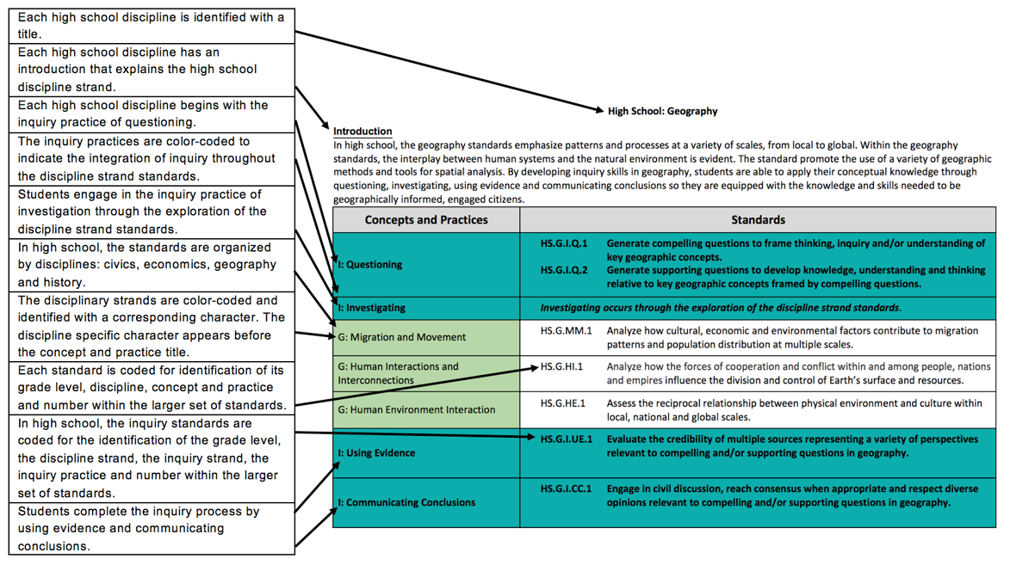
KAS for Social Studies – Standards View
Notes:
The KAS for Social Studies for high school is organized within a similar architecture but the high school standards are organized around the disciplines of civics, economics, geography and US and World History rather than being organized around a theme.
Each high school discipline is identified with a title and introduction that provides information about the discipline. Each high school discipline begins with the inquiry practice of questioning. The inquiry practices are color-coded to indicate the integration of inquiry throughout the grade level standards. Students engage in the inquiry practice of investigation through the exploration of the discipline strand standards. The disciplinary strands civics, economics, geography and history are color coded and identified with a corresponding character. The discipline specific character appears before the concept and practice title. Each standard is coded for identification of its grade level, discipline, concept and practice and number within the larger set of standards. In high school, the inquiry standards are coded for the identification of the grade level, the discipline strand, the inquiry strand, the inquiry practice and number within the larger set of standards. Students complete the inquiry process by using evidence and communicating conclusions.

Slide 6
KAS for Social Studies
Grade 6: Development of Civilizations
Specific Overview
Grade 6: Introduction
The goal of social studies education is for students to develop thinking and decision-making skills that prepare them for responsible citizenship in a democratic society. Sixth graders continue to work toward this goal by investigating the emergence and development of civilizations in River Valley Civilizations (Ancient Mesopotamia, Ancient Egypt, Ancient India and Ancient China) and Classical Empires between 3500 BCE-600 CE. Students will explain the origins, functions and structures of governments. Students explain how markets exist whenever there is an exchange of goods and services. Students compare how human and environmental characteristics of a region influenced the movement of people, goods and ideas. Students will compare the origins and development of early world religions. Students will describe how River Valley Civilizations transitioned to empires. Through an understanding of ancient history, students develop an appreciation for the foundations of the modern world.
Key Vocabulary:
May include, but is not limited to: citizen, Classical Empire, democracy, hunter-gatherer societies, monarchy, monotheism, Neolithic Revolution, polytheism, republic, River Valley Civilization, theocracy
Looking Back, Looking Ahead: Connections to Grade 5 and 6
In grade 5, students examine the tensions and factors that led to the fight for independence and the establishment of the United States of America. In grade 6, students use their knowledge of the formation of the government and society of the United States to explore the development of early civilizations throughout the world. In grade 7, students examine how movement and migration impacted the interactions between expanding civilizations through conquest and trade in Afro-Eurasia (North Africa, Sub-Saharan Africa, Asia and Europe) and the Americas from 600-1600.
Notes:
Based on feedback provided since the December Kentucky Board of Education meeting, grade-level specific overviews were added to the Kentucky Academic Standards (KAS) for Social Studies document in kindergarten through grade 8. In K-8, each grade level is introduced with a grade-level specific overview that includes an expanded grade-level introduction, suggested key vocabulary, connections to the previous and following grade, and an explanation of what inquiry looks like in practice. The grade-level theme presented in the introduction drives the standards within the concepts and practices through the four disciplines of civics, economics, geography and history.
Grade-level introductions: Feedback indicated that stakeholders valued the additional clarity of an expanded introduction specific to each grade level. The expanded introduction provides additional information on the grade-level theme and explains how the goal of social studies education connects with students as they progress through their social studies education. Additionally, the expanded introduction provides examples of how learners engage with each of the four disciplines during the year.
Suggested key vocabulary: Feedback indicated that stakeholders valued suggested key vocabulary specific to each grade level. The writing committee identified terms that they felt were essential to understanding the content and skills in the standards. The identified key vocabulary terms listed are possible suggestions; they are not the only terms that may be used during instruction.
Looking Back, Looking Ahead: progression snapshots: Feedback indicated that stakeholders valued the progression snapshots found in the overviews. Short summaries of the previous and following grades are included to provide educators information on what a student’s social studies learning experience is focused on in the previous and following grade. This short snapshot provides a short narrative on how the current grade’s theme progresses.

Slide 7
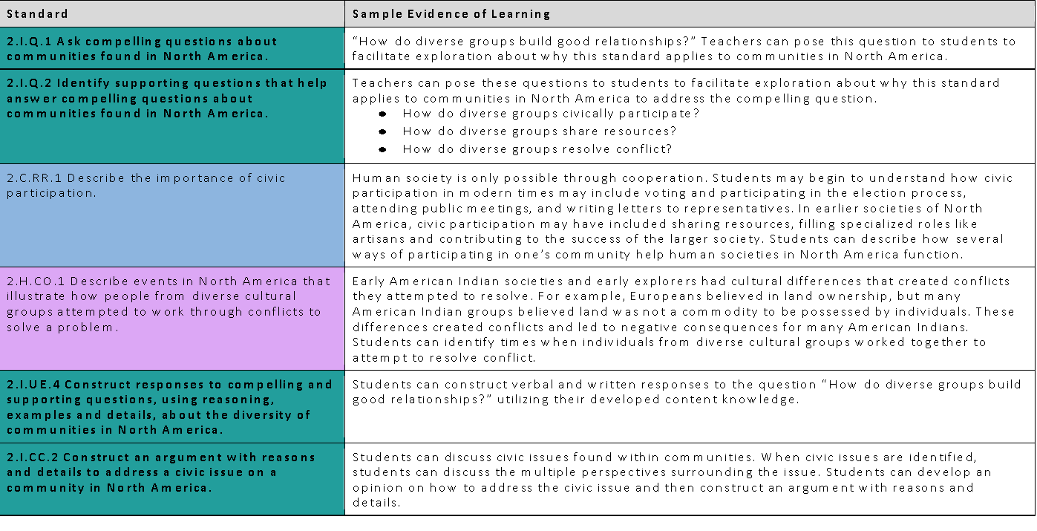
Specific Overview
What this would look like in practice
This example provides guidance on how to combine the standards into a learning experience for students and how the standards work together to ensure students are engaged in the inquiry practices throughout grade 2. The identified sample evidence of learning is a possible suggestion of how the disciplinary strand standards interact with the inquiry practices; however, it is not the only pathway and is not comprehensive to obtain mastery of the standards.
Notes:
Feedback provided indicated that supports were needed to assist stakeholders in seeing how the inquiry and discipline strand standards interact in a learning experience. This section provides guidance on how to combine the standards into a learning experience for students and how the standards work together to ensure students are engaged in the inquiry practices throughout K-8. The identified sample evidence of learning is a possible suggestion of how the disciplinary strand standards interact with the inquiry practices; however, it is not the only pathway and is not comprehensive to obtain mastery of the standards.

Slide 8
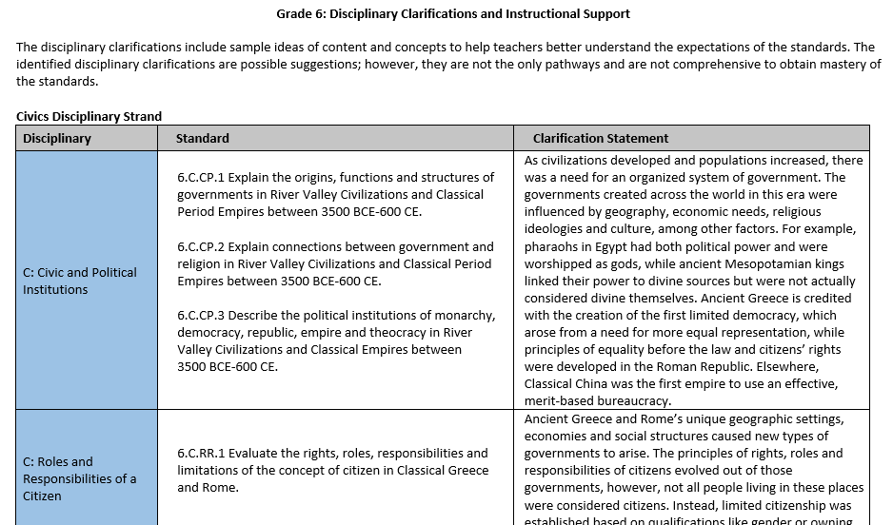
Disciplinary Clarifications
Notes:
Based on feedback provided, disciplinary clarifications were added in kindergarten through grade 8. Following the grade-level standards for each grade, disciplinary clarifications are provided. The disciplinary clarifications include sample ideas of content and concepts to help teachers better understand the expectations of the standards. The identified disciplinary clarifications are possible suggestions; however, they are not the only pathways and are not comprehensive to obtain mastery of the standards.

Slide 9
Proposed Kentucky Academic Standards for Social Studies
Additional Highlights:
Grade level content standards to promote foundational learning in K-3
Kentucky studies through a child’s social studies education K-12
Opportunities for Cross Disciplinary Connections
Organized in progressions from K-12 by grade level, inquiry practice, discipline, and concepts and practices
Notes:
Additional Highlights of the KAS for Social Studies include the following:
There are grade level content standards to promote foundational learning in K-3.
There are Kentucky studies standards throughout a child’s social studies education K-12 , where appropriate. It is important to note that the Kentucky studies standards are discipline specific so there are Kentucky Civics, Kentucky Economics, Kentucky Geography and Kentucky History standards.
Based on feedback provided, opportunities for cross disciplinary connections were identified. Feedback provided indicated that teachers needed support, especially at the elementary school level, when understanding how cross disciplinary connections could be made among the content standards. In this section, connections are made between the KAS for Social Studies and the Kentucky Academic Standards (KAS) for Reading and Writing.
In the Progression appendix, the standards are organized in progressions from K-12 by grade level, inquiry practice, discipline, and concepts and practices

Slide 10
Draft KAS for Social Studies
Do a Google search for KSBA Public Portal
Select the option for KBE Board Meetings from the Google page
Access the 4/10/2019 meeting information

Slide 11
5 Things to Know Before You Go:
Visit kystandards.org for resources
June Conference
Louisville location added for June 11
Registration links on kystandards.org
Subscription emails
Make sure to check your junk mail
Contact your state content organization for support
Next week’s webcast: Interdisciplinary Literacy Practices

