Slide 1
Getting to Know the
Kentucky Academic Standards for Health & the Kentucky Academic Standards for Physical Education
Module 1: Section 1A:
Revision Process Overview

Slide 2
Group Norms
Assume best intentions.
Listen carefully to one another.
Be open to new ideas.
Be open to working outside your comfort zone.
Ask questions.
Allow a chance for everyone to participate.

Slide 3
Setup for Success: Brainwriting
What is something you tried in your classroom this year for the first time? How did it go?
What is one way you grew professionally this year?
Who amongst your colleagues was the most helpful to you? Why?
In what ways were you helpful to your colleagues this year?

Slide 4
Module Goal:
Build a shared understanding of the KAS for Health Education & the KAS for
Physical Education document.
Strengthen the connection between the components of the KAS for
Health Education & the KAS for Physical Education and the way those components can support teachers in the process of designing instruction.
Experience how the changes in the KAS for Health Education & the KAS for Physical Education can and should be reflected in student experiences within our classrooms.
Identify and prioritize areas where future professional learning opportunities will be needed in the implementation process with the new KAS for Health Education & the KAS for Physical Education and discuss the plan to address those areas.

Slide 5
Section 1A: Essential Questions
Where did the KAS for Health Education & the KAS for Physical Education come from?
Did we really need new standards?
Who wrote the standards?

Slide 6
SB1 (2017) Standards Revision Requirements
The standards revision to the content standards shall:
Focus on critical knowledge, skills, and capacities needed for success in the global economy;
Result in fewer, but more in-depth standards to facilitate mastery learning;
Communicate expectations more clearly and concisely to teachers, parents, students and citizens;
Be based on evidence-based research;
Consider international benchmarks; and
Ensure that the standards are aligned from elementary to high school to post-secondary education so that students can be successful at each education level.

Slide 7
Standards Creation Process
Advisory Panels (APs)
APs will consist of at least six public school educators who teach the content standards being reviewed along with a representative from an institution of higher education in Kentucky for each grade band: elementary (K-5), middle (6-8) and high school.
The function of the AP was to review the standards and make recommendations for changes to a Review Development Committee (RDC).
In addition to the standards’ revisions, the AP created a new architectural structure for the standards.

Slide 8
Standards Creation Process
Standards Review & Development Committees (RDC)
RDC will consist of a minimum of six public school educators, who teach in the academic content area being reviewed, and two representatives from higher education, as well as other community shareholders comprise each committee.
The function of the RDC was to review the work and findings from the AP and make recommendations to revise or replace existing standards.

Slide 9
Additional Legislation: Health Education
KRS 158.6453 Drug Awareness and Prevention:
The academic standards in practical living skills for elementary, middle and high school levels shall include a focus on drug abuse prevention, with an emphasis on the prescription drug epidemic and the connection between prescription opioid abuse and addiction to other drugs, such as heroin and synthetic drugs.
KRS 158.301 Schools Encouraged to Educate Students on Risks of Exposure to Ultraviolet Rays
The General Assembly hereby encourages each public school to provide age appropriate education to all students on the risks associated with exposure to ultraviolet rays from natural sunlight and artificial sources.
KRS 158.302 Cardiopulmonary Resuscitation Training Required for High School Students
Every public high school shall provide cardiopulmonary resuscitation training to students as part of the health course or the physical education course that is required for high school graduation or the Junior Reserve Officers Training Corps course that meets the physical education requirement.

Slide 10
Writer’s Vision: Health Education
All students have the opportunity to develop the necessary skills to master health literacy.
Health literacy is the “degree to which individuals have the capacity to obtain, process and understand basic health information and services needed to make appropriate health decisions” (National Network of Libraries of Medicine).
The writers wanted students to have opportunities to:
practice the skills needed to access valid and reliable health information
set achievable health goals
make healthy decisions
use products effectively
advocate for their own health.

Slide 11
Additional Legislative: Physical Education
KRS 160.345 School Wellness Policy
Each school council of a school containing grades K-5 or any combination thereof, or if there is no school council, the principal, shall develop and implement a wellness policy that includes moderate to vigorous physical activity each day and encourages healthy choices among students. The policy may permit physical activity to be considered part of the instructional day, not to exceed thirty (30) minutes per day, or one hundred and fifty (150) minutes per week.
School districts can develop wellness policies to meet the unique needs of each school under its jurisdiction, but at a minimum are required to: include goals for nutrition promotion and education, physical activity and other school-based activities that promote students wellness.

Slide 12
Writer’s Vision: Physical Education
Background: The goal of physical education is to provide Kentucky students with the knowledge and skills needed to establish and maintain physically healthy lifestyles.
All students have the opportunity to become physically literate.
Due to the importance of helping students understand the benefits of living a healthy lifestyle that promotes personal development, the writers constructed standards that afford teachers the autonomy to successfully convey the benefits of regular physical activity in tandem with the skills needed to sustain lifelong health and wellness.
The writers explicitly attempted to outline learning experiences that ultimately contribute to each students’ well-being.

Slide 13
Section 1A: Essential Questions
Where did the KAS for Health Education and the KAS for Physical Education come from?
Did we really need new standards?
Who wrote the standards?

Slide 14
Coming Up...
Section 1B: Understanding the Architecture: Kentucky Academic Standards for Health Education
Section 1C: Planning Instruction Aligned to the KAS for Health Education
Section 1D: Understanding the Architecture: Kentucky Academic Standards for Physical Education
Section 1E: Planning Instruction Aligned to the KAS for Physical Education
Section 1F: Wrap Up & Next Steps

Slide 15
End of 1A
Stop here if you are completing Module 1: Section 1A: Revision Process Overview only.
The KDE needs your feedback on the effectiveness of this module, the learning platform and how the consultants may best support you as you take the next steps in the implementation process. Feedback from the surveys will be used by the KDE to plan and prepare future professional learning.
Module 1 Survey: https://www.surveymonkey.com/r/KAS-health-physical-education
If you want to complete another section of Module 1 at this time, continue onto the next slide to begin facilitating Module 1: Section 1B: Understanding the Architecture: Kentucky Academic Standards for Health Education.

Slide 16
Getting to Know the
KAS for Health Education & the KAS for Physical Education
Module 1: Section 1B:
Understanding the Architecture:
KAS for Health Education

Slide 17
Group Norms
Assume best intentions.
Listen carefully to one another.
Be open to new ideas.
Be open to working outside your comfort zone.
Ask questions.
Allow a chance for everyone to participate.

Slide 18
Module Goal:
Build a shared understanding of the KAS for Health Education & the KAS for
Physical Education document.
Strengthen the connection between the components of the KAS for
Health Education & the KAS for Physical Education and the way those components can support teachers in the process of designing instruction.
Experience how the changes in the KAS for Health Education & the KAS for Physical Education can and should be reflected in student experiences within our classrooms.
Identify and prioritize areas where future professional learning opportunities will be needed in the implementation process with the new KAS for Health Education & the KAS for Physical Education and discuss the plan to address those areas.

Slide 19
Section 1B: Essential Questions
What are the key components of the KAS for Health Education?
How will the components of the architecture support teachers/schools/districts in successfully implementing the KAS for Health Education?
What opportunities for engaging other stakeholders are created by the KAS for Health Education?

Slide 20
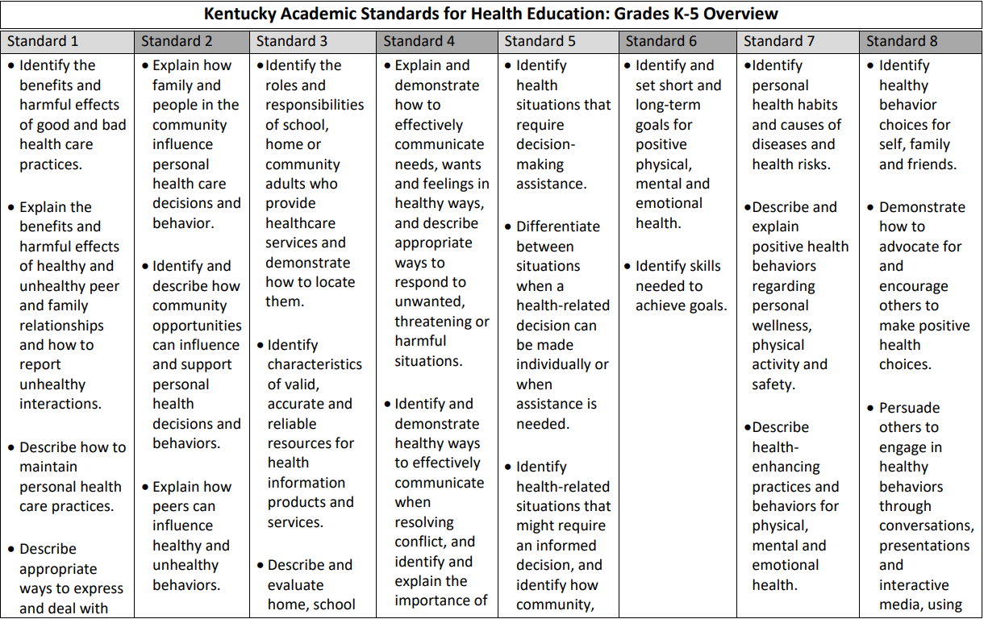
p. 11 of KAS for Health Education

Slide 21
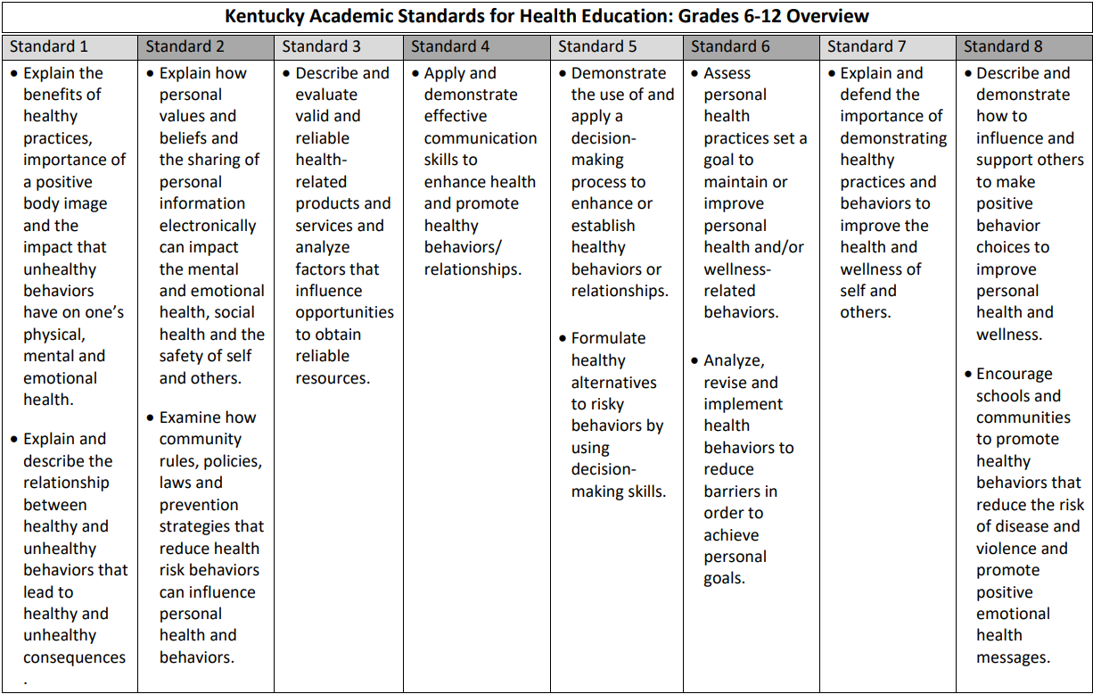
p. 32 of KAS for HealthEducation

Slide 22
Food for thought:
Do you see any connections in learning across the eight standards listed in the overview?
How might the information in the overview of the KAS for Health Education be useful for
Teachers?
Administrators?
Parents?
Students?
Citizens?

Slide 23
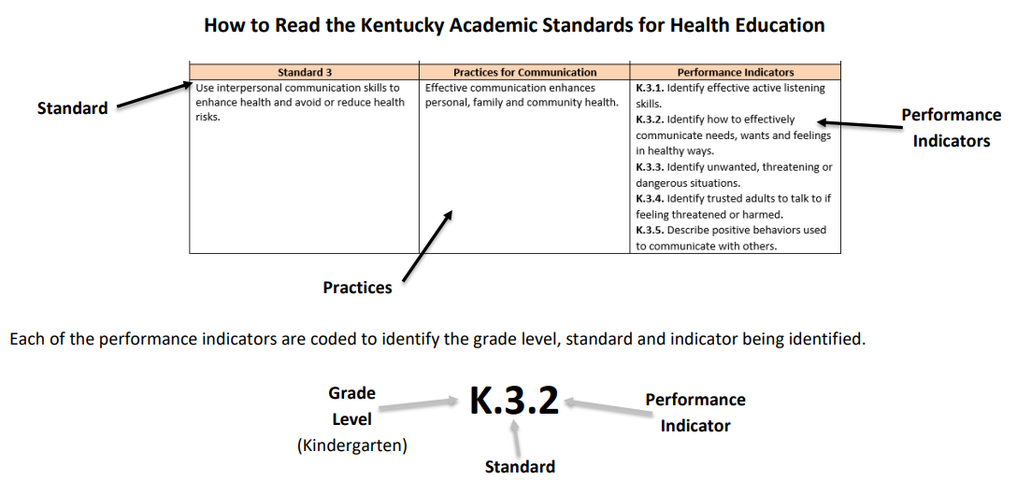
Understanding the Architecture
The KAS for Health Education are organized into three parts:
1. The Standards
2. The Practices
3. The Performance Indicators

Slide 24
Understanding the Architecture
The Standards:
provide cognitive content to promote healthy lifestyles throughout childhood, adolescence and into adulthood
Communicate the broader learning of performance indicators that promote and produce health literate students in all grade levels.
Standards are the overarching ideas that support reaching the end goal of creating health literate students.
Standards are not meant to be mastered in one or two lessons; rather, acquiring these skills is the outcome of a comprehensive, sequential, health education.

Slide 25
Understanding the Architecture
The Practices:
Explain the health education standard and what students will know and be able to demonstrate as health literate individuals in
analyzing influences,
accessing valid information,
communication,
decision-making,
goal-setting,
health-enhancing behaviors and
advocacy.
Provide clarity, direction and understanding for the standards and how they connect to the performance indicators.

Slide 26
Understanding the Architecture
The Performance Indicators:
Focus on advocacy and accessing valid information to promote health-enhancing behaviors and disease prevention.
Are the expectation of what students should know and be able to do by the end of each grade level.
Clearly define grade level expectations that lead to the goal of health literate students.

Slide 27
Food for thought:
How might the information within each grade level of the KAS for Health Education be useful for
Teachers?
Administrators?
Parents?
Students?
Citizens?

Slide 28
Section 1B: Essential Questions
What are the key components of the KAS for Health Education?
How will the components of the architecture support teachers/schools/districts in successfully implementing the KAS for Health Education?
What opportunities for engaging other stakeholders are created by the KAS for Health Education?

Slide 29
Coming Up...
Section 1C: Planning Instruction Aligned to the KAS for Health Education
Section 1D: Understanding the Architecture: Kentucky Academic Standards for Physical Education
Section 1E: Planning Instruction Aligned to the KAS for Physical Education
Section 1F: Wrap Up & Next Steps

Slide 30
End of Section B
Stop here if you are completing Module 1: Section 1B: Understanding the Architecture: KAS for Health Education only.
The KDE needs your feedback on the effectiveness of this module, the learning platform and how the consultants may best support you as you take the next steps in the implementation process. Feedback from the surveys will be used by the KDE to plan and prepare future professional learning.
Module 1 Survey: https://www.surveymonkey.com/r/KAS-health-physical-education
If you want to complete another section of Module 1 at this time, continue onto the next slide to begin facilitating Module 1: Section 1C: Planning Instruction Aligned to the KAS for Health Education.

Slide 31
Getting to Know the
KAS for Health Education & the KAS for Physical Education
Module 1: Section 1C:
Planning Instruction Aligned to the KAS for Health Education

Slide 32
Group Norms
Assume best intentions.
Listen carefully to one another.
Be open to new ideas.
Be open to working outside your comfort zone.
Ask questions.
Allow a chance for everyone to participate.

Slide 33
Module Goal:
Build a shared understanding of the KAS for Health Education & the KAS for
Physical Education document.
Strengthen the connection between the components of the KAS for
Health Education & the KAS for Physical Education and the way those components can support teachers in the process of designing instruction.
Experience how the changes in the KAS for Health Education & the KAS for Physical Education can and should be reflected in student experiences within our classrooms.
Identify and prioritize areas where future professional learning opportunities will be needed in the implementation process with the new KAS for Health Education & the KAS for Physical Education and discuss the plan to address those areas.

Slide 34
Setup for Success: One + One = One
Think of the name of an object that begins with the same letter as your last name and write the name on a post-it-note.
Examples: M = meal, A = apple, C = credit card and so on
Move around the room and combine your object with someone else’s to create something new.
For example:
Deck + Legos = A put-it-together adjustable wooden deck that can be dismantled and stored.
Bomb + Bath = Doggie bath bombs. The bombs are made of pet shampoo that has been molded into a solid form. You throw the bomb in the water and it bubbles and fizzes, saving you the trouble of holding on to the slippery shampoo bottle and your squirmy dog at the same time.

Slide 35
Section 1C: Essential Questions
What is the value in reflecting upon current assignments, lessons, units, etc. to determine whether the instruction will align with the KAS for Health Education?
What are some resources that might provide direction to educators when designing instruction aligned to the KAS for Health Education?

Slide 36
Discovery Task: Connecting with the Content
How might you approach designing instruction differently with these performance indicators in mind? Are there specific instructional strategies that could be utilized?
How is engaging in the listed practice going to benefit your students? Why will it be important that educators are intentional about providing opportunities to engage in the practices throughout the content instead of teaching them in isolated activities?
How might engaging in this practice benefit students in areas outside of health class? Are there certain standards/practices/performance indicators that offer opportunities for collaborating with community partners?

Slide 37
Discovery Task: Connecting with the Content
Part 2
What connects can be made within the grade level expectations?
How can your instruction (tasks, activities, assessments, etc.) intentionally target the standards at grade level?
Are there standards that could be incorporated into a longer term school/community partnership that has students participating in different roles as the expectations for their age progress?

Slide 38
KAS for Health Education: Think-Pair-Share
T : (Think)
Was there something that came up when your group was discussing the tasks that stood out in your mind as something that was an “aha” or something that you might want to consider more in depth later when you are working on standards alignment and implementation?
P : (Pair) Pair with another participant or a small group.
S : (Share) Share your thinking with your partner.

Slide 39
The KAS for Health Education is...
The KAS for Health Education is NOT...
An outline of the goals or outcomes of an educational program.
A statement of what students should be able to know and do after instruction.
An outline of how learning experiences are to be designed, or what resources should be used.

Slide 40
The KAS for Health Education does...
The KAS for Health Education does NOT...
Establish what students should know and be able
to demonstrate at the conclusion of a course.
Dictate curriculum or teaching methods.
Dictate the design of a lesson or how units should be organized.

Slide 41
Considerations When Developing Curriculum:
Comprehensive school health education includes courses of study (curricula) for students in pre-K - 12 that address a variety of topics such as alcohol and other drug use and abuse, healthy eating/nutrition, mental and emotional health, personal health and wellness, physical activity, safety and injury prevention, sexual health, tobacco use, and violence prevention.
It is critical that any discussion of outside resources occurs only AFTER a deeper investigation of the KAS for Health Education has taken place. Without a deep understanding of the KAS for Health Education, it will be very difficult to make quality decisions when determining whether the resource in question (activity, task, assignment, assessment, etc.) is actually aligned to the standards.

Slide 42
Resources for Schools & Districts to Consider When Developing Curriculum:

Slide 43
Resources for Schools & Districts to Consider When Developing Curriculum:
Kentucky Office of Drug Control Policy
2018 Drug Use Prevention Guide
Over the past decade, the number of Kentuckians who die from drug overdoses has steadily climbed to more than 1,500 each year, exacting a devastating toll on families, communities, social services and economic stability and growth.
Children who witness drug abuse are more likely to use drugs as adults, which can prevent them from achieving their full potential.
Comprehensive prevention education helps students stay drug-free, make healthy choices and succeed academically.

Slide 44
Discovery Task:
Planning Guide for Utilizing the 2018 Drug Use Prevention Curriculum Resource Guide
Explore the hyperlinked resources in the guide to determine where they would fit in within the grade level expectations set forth by the KAS for Health Education.
Make note of any considerations for implementation, such as whether the program would require a monetary investment or whether any outside partners might participate in the implementation.
Include any additional notes regarding the resource that may be useful in future planning.

Slide 45
Resources for Schools & Districts to Consider When Developing Curriculum:
Centers for Disease Control and Prevention (CDC)
Characteristics of an Effective Health Education Curriculum
Today’s state-of-the-art health education curricula reflect the growing body of research that emphasizes
Teaching functional health information (essential knowledge)
Shaping personal values and beliefs that support healthy behaviors
Shaping group norms that value a healthy lifestyle
Developing the essential health skills necessary to adopt, practice, and maintain health-enhancing behaviors.
Less effective curricula often overemphasize teaching scientific facts and increasing student knowledge.

Slide 46
Resources for Schools & Districts to Consider When Developing Curriculum:
Centers for Disease Control and Prevention (CDC)
Health Education Curriculum Analysis Tool (HECAT)
Guidance on using the HECAT to review curricula and using the HECAT results to make health education curriculum decisions
Customizable templates for recording important descriptive curriculum information for state or local use in the curriculum review process
Tools to analyze preliminary curriculum considerations, such as accuracy, acceptability, feasibility, and affordability
Tools to analyze curriculum fundamentals, such as teacher materials, instructional design, and instructional strategies and materials
Specific health-topic concept and skills analyses
Guidance on using the HECAT for developing a health education scope and sequence

Slide 47
Section 1C: Essential Questions
What is the value in reflecting upon current assignments, lessons, units, etc. to determine whether the instruction will align with the KAS for Health Education?
What are some resources that might provide direction to educators when designing instruction aligned to the KAS for Health Education?

Slide 48
Coming Up...
Section 1D: Understanding the Architecture: Kentucky Academic Standards for Physical Education
Section 1E: Planning Instruction Aligned to the KAS for Physical Education
Section 1F: Wrap Up & Next Steps

Slide 49
End of Section C
Stop here if you are completing Module 1: Section 1C: Planning Instruction Aligned to the KAS for Health Education only.
The KDE needs your feedback on the effectiveness of this module, the learning platform and how the consultants may best support you as you take the next steps in the implementation process. Feedback from the surveys will be used by the KDE to plan and prepare future professional learning.
Module 1 Survey: https://www.surveymonkey.com/r/KAS-health-physical-education
If you want to complete another section of Module 1 at this time, continue onto the next slide to begin facilitating Module 1: Section 1D: Understanding the Architecture: KAS for Physical Education.

Slide 50
Getting to Know the
KAS for Health Education and the KAS for Physical Education
Module 1: Section 1D:
Understanding the Architecture:
KAS for Physical Education

Slide 51
Group Norms
Assume best intentions.
Listen carefully to one another.
Be open to new ideas.
Be open to working outside your comfort zone.
Ask questions.
Allow a chance for everyone to participate.

Slide 52
Module Goal:
Build a shared understanding of the KAS for Health Education & the KAS for
Physical Education document.
Strengthen the connection between the components of the KAS for
Health Education & the KAS for Physical Education and the way those components can support teachers in the process of designing instruction.
Experience how the changes in the KAS for Health Education & the KAS for Physical Education can and should be reflected in student experiences within our classrooms.
Identify and prioritize areas where future professional learning opportunities will be needed in the implementation process with the new KAS for Health Education & the KAS for Physical Education and discuss the plan to address those areas.

Slide 53
Section 1D: Essential Questions
What are the key components of the KAS for Physical Education?
How will the components of the architecture support teachers/schools/districts in successfully implementing the KAS for Physical Education?
What opportunities for engaging other stakeholders are created by the KAS for Physical Education?

Slide 54
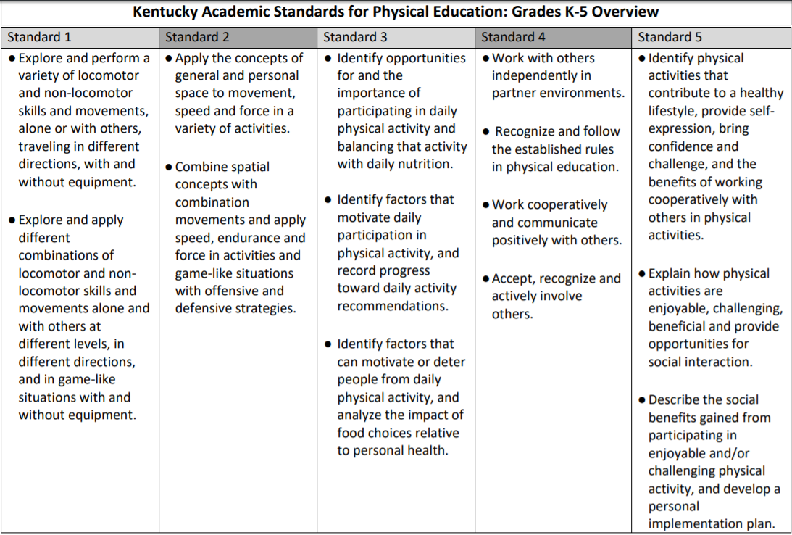
p. 10 of KAS for Physical Education

Slide 55
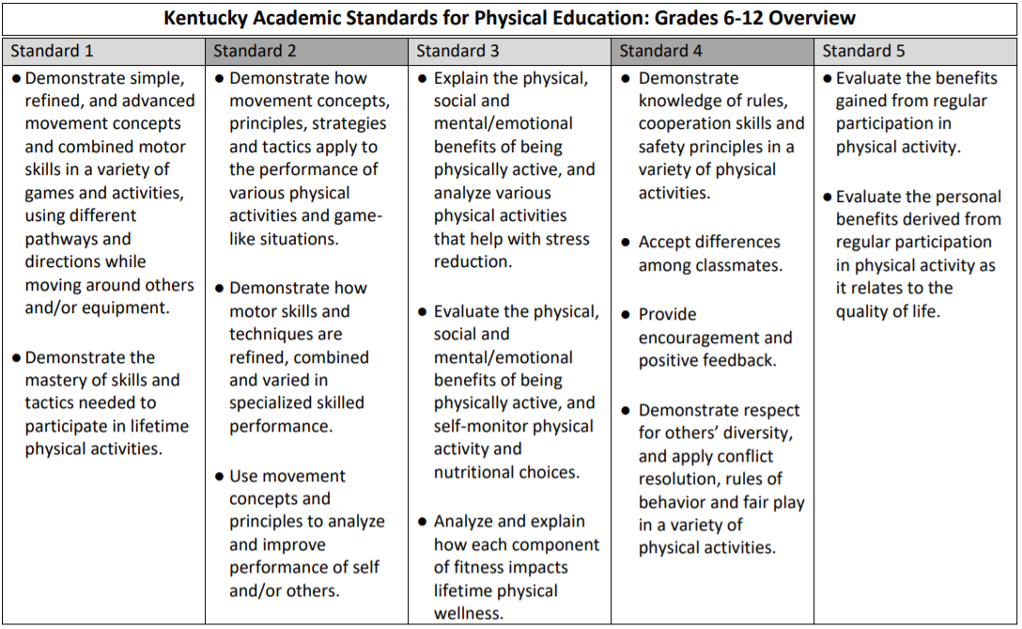
p. 23 of the KAS for Physical Education

Slide 56
Food for thought:
Do you see any connections in learning across the five standards listed in the overview?
How might the information in the overview of the KAS for Physical Education be useful for
Teachers?
Administrators?
Parents?
Students?
Citizens?

Slide 57
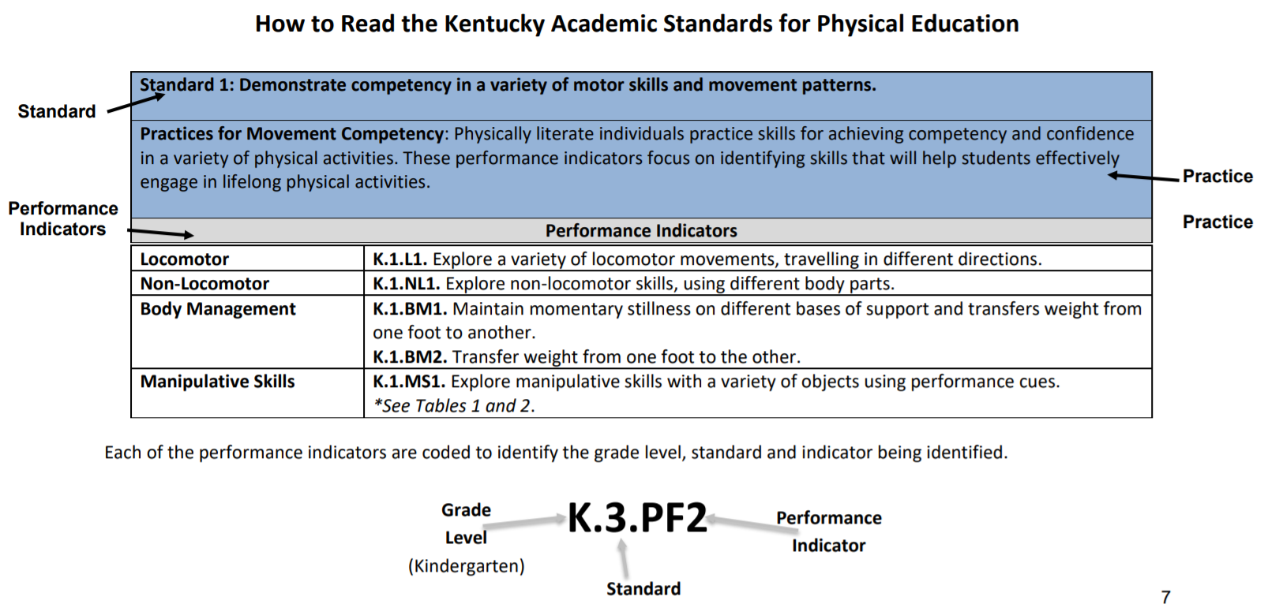
Understanding the Architecture
The KAS for Physical Education are organized into three parts:
1. The Standards
2. The Practices
3. The Performance Indicators

Slide 58
Understanding the Architecture
The Standards:
provide cognitive content to develop and maintain active lifestyles throughout childhood, adolescence and into adulthood.
Communicate the broader learning of performance indicators that promote and produce physically literate students in all grade levels.
Standards are the overarching ideas that support reaching the end goal of creating physically literate students.
Standards are not meant to be mastered in one or two lessons; rather, acquiring these skills is the outcome of a comprehensive, sequential, physical education.

Slide 59
Understanding the Architecture
The Practices:
Explains the physical education standard and what students will be able to demonstrate as being physically literate in
Movement competency
Application of movement performance
Health-enhancing physical activity
Personal and social behaviors
The value of physical activity
Provide clarity, direction and understanding for the standards and how they connect to the performance indicators.

Slide 60
Understanding the Architecture
The Performance Indicators:
Focus on building
Physical competence
Motivation
Confidence
Knowledge
Are the expectation of what students should know and be able to do by the end of each grade level.
Clearly define grade level expectations that lead to the goal of physically literate students.

Slide 61
Food for thought:
How might the information within each grade level of the KAS for Physical Education be useful for
Teachers?
Administrators?
Parents?
Students?
Citizens?

Slide 62
Section 1D: Essential Questions
What are the key components of the KAS for Physical Education?
How will the components of the architecture support teachers/schools/districts in successfully implementing the KAS for Physical Education?
What opportunities for engaging other stakeholders are created by the KAS for Physical Education?

Slide 63
Coming Up...
Section 1E: Planning Instruction Aligned to the KAS for Physical Education
Section 1F: Wrap Up & Next Steps

Slide 64
End of Section 1D
Stop here if you are completing Module 1: Section 1D: Understanding the Architecture: KAS for Physical Education only.
The KDE needs your feedback on the effectiveness of this module, the learning platform and how the consultants may best support you as you take the next steps in the implementation process. Feedback from the surveys will be used by the KDE to plan and prepare future professional learning.
Module 1 Survey: https://www.surveymonkey.com/r/KAS-health-physical-education
If you want to complete another section of Module 1 at this time, continue onto the next slide to begin facilitating Module 1: Section 1E: Planning Instruction Aligned to the KAS for Physical Education.

Slide 65
Getting to Know the
KAS for Health Education and the KAS for Physical Education
Module 1: Section 1E:
Planning Instruction Aligned to the KAS for Physical Education

Slide 66
Group Norms
Assume best intentions.
Listen carefully to one another.
Be open to new ideas.
Be open to working outside your comfort zone.
Ask questions.
Allow a chance for everyone to participate.

Slide 67
Module Goal:
Build a shared understanding of the KAS for Health Education & the KAS for
Physical Education document.
Strengthen the connection between the components of the KAS for
Health Education & the KAS for Physical Education and the way those components can support teachers in the process of designing instruction.
Experience how the changes in the KAS for Health Education & the KAS for Physical Education can and should be reflected in student experiences within our classrooms.
Identify and prioritize areas where future professional learning opportunities will be needed in the implementation process with the new KAS for Health Education & the KAS for Physical Education and discuss the plan to address those areas.

Slide 68
Section 1E: Essential Questions
What is the value in reflecting upon current assignments, lessons, units, etc. to determine whether the instruction will align with the KAS for Physical Education?
What are some resources that might provide direction to educators when designing instruction aligned to the KAS for Physical Education?

Slide 69
Discovery Task: Connecting with the Content
How might you approach designing instruction differently with these performance indicators in mind? Are there specific instructional strategies that could be utilized?
How is engaging in the listed practice going to benefit your students? Why will it be important that educators are intentional about providing opportunities to engage in the practices throughout the content instead of teaching them in isolated activities?
How might engaging in this practice benefit students in areas outside of PE class? Are there certain standards/practices/performance indicators that offer opportunities for collaborating with community partners?

Slide 70
Discovery Task: Connecting with the Content
Part 2
What connects can be made within the grade level expectations?
How can your instruction (tasks, activities, assessments, etc.) intentionally target the standards at grade level?
Are there standards that could be incorporated into a longer term school/community partnership that has students participating in different roles as the expectations for their age progress?

Slide 71
KAS for Physical Education: Think-Pair-Share
T : (Think)
Was there something that came up when your group was discussing the tasks that stood out in your mind as something that was an “aha” or something that you might want to consider more in depth later when you are working on standards alignment and implementation?
P : (Pair) Pair with another participant or a small group.
S : (Share) Share your thinking with your partner.

Slide 72
The KAS for Physical Education is...
The KAS for Physical Education is NOT...
An outline of the goals or outcomes of an educational program.
A statement of what students should be able to know and do after instruction.
An outline of how learning experiences are to be designed, or what resources should be used.

Slide 73
The KAS for Physical Education does...
The KAS for Physical Education does NOT...
Establish what students should know and be able
to demonstrate at the conclusion of a course.
Dictate curriculum or teaching methods.
Dictate the design of a lesson or how units should be organized.

Slide 74
Resources for Schools & Districts to Consider When Developing Curriculum:
In Kentucky schools, the KAS for Physical Education direct schools and districts to develop quality physical education programs for students at an age appropriate level.
It is critical that any discussion of outside resources occurs only AFTER a deeper investigation of the KAS for Physical Education has taken place. Without a deep understanding of the KAS for Physical Education, it will be very difficult to make quality decisions when determining whether the resource in question (activity, task, assignment, assessment, etc.) is actually aligned to the standards.

Slide 75
Resources for Schools & Districts to Consider When Developing Curriculum:
Centers for Disease Control and Prevention (CDC)
Physical Education Curriculum Analysis Tool (PECAT)
A self-assessment and planning guide developed by CDC. It is designed to help school districts and schools conduct clear, complete, and consistent analyses of physical education curricula, based upon national physical education standards.
Assesses how closely physical education curricula align with national standards for high quality physical education programs
Analyzes content and student assessment components of a curriculum that correspond to national standards for physical education for four grade levels: K–2, 3–5, 6–8, and 9–12
Helps school districts or individual schools identify changes needed in locally developed curricula

Slide 76
Resources for Schools & Districts to Consider When Developing Curriculum:
Society of Health and Physical Educators (SHAPE)
SHAPE defines four essential components of physical education programs:
Policy & Environment
Curriculum
Appropriate Instruction
Student Assessment
The Essential Components of Physical Education
SHAPE America has re-envisioned the essential components that provide the structure for a physical education program (p. 4). The purpose of this document is not only to delineate those essential components, but also to identify physical education as a key element of a well-rounded education for all students.

Slide 77
Resources for Schools & Districts to Consider When Developing Curriculum:
Society of Health and Physical Educators (SHAPE)
SHAPE defines four essential components of physical education programs:
Policy & Environment
Curriculum
Appropriate Instruction
Student Assessment
Physical Education Program Checklist
This Physical Education Program Checklist is designed to help school administrators, principals, teachers and parents review their schools’ physical education programs to ensure that they are addressing what SHAPE America has identified as the “essential components” of physical education (SHAPE America, 2015).

Slide 78
Resources for Schools & Districts to Consider When Developing Curriculum:
Society of Health and Physical Educators (SHAPE)
SHAPE defines four essential components of physical education programs:
Policy & Environment
Curriculum
Appropriate Instruction
Student Assessment
Appropriate Instructional Practice Guidelines, K-12
This tool includes developmentally appropriate and inappropriate practices in elementary, middle and high school physical education classes.
Each section is broken down into subsections that focus on specific areas of concern in physical education.

Slide 79
Resources for Schools & Districts to Consider When Developing Curriculum:
Society of Health and Physical Educators (SHAPE)
SHAPE defines four essential components of physical education programs:
Policy & Environment
Curriculum
Appropriate Instruction
Student Assessment
20 Indicators of Effective Physical Education Instruction
When conducting a walk-through evaluation or an evaluative observation of a physical education class, school administrators should expect to see the following practices.

Slide 80
Section 1E: Essential Questions
What is the value in reflecting upon current assignments, lessons, units, etc. to determine whether the instruction will align with the KAS for Physical Education?
What are some resources that might provide direction to educators when designing instruction aligned to the KAS for Physical Education?

Slide 81
Coming Up...
Section 1F: Wrap Up & Next Steps

Slide 82
End of Section E
Stop here if you are completing Module 1: Section 1E: Planning Instruction Aligned to the KAS for Physical Education only.
The KDE needs your feedback on the effectiveness of this module, the learning platform and how the consultants may best support you as you take the next steps in the implementation process. Feedback from the surveys will be used by the KDE to plan and prepare future professional learning.
Module 1 Survey: https://www.surveymonkey.com/r/KAS-health-physical-education
If you want to complete another section of Module 1 at this time, continue onto the next slide to begin facilitating Module 1: Section 1F: Wrap Up & Next Steps.

Slide 83
Getting to Know the
KAS for Health Education & the KAS for Physical Education
Module 1: Section 1F:
Wrap Up & Next Steps

Slide 84
Group Norms
Assume best intentions.
Listen carefully to one another.
Be open to new ideas.
Be open to working outside your comfort zone.
Ask questions.
Allow a chance for everyone to participate.

Slide 85
Module Wrap Up
Module 1: Getting to Know the KAS for Health Education & the KAS for Physical Education
Section 1A: Revision Process Overview
Section 1B: Understanding the Architecture: KAS for Health Education
Section 1C: Planning Instruction Aligned to the KAS for Health Education
Section 1D: Understanding the Architecture: KAS for Physical Education
Section 1E: Planning Instruction Aligned to the KAS for Physical Education
Section 1F: Wrap Up & Next Steps
These sessions are intended to support the successful transition to and implementation of the KAS for Health Education and the KAS for Physical Education in classrooms across the state.

Slide 86
Pain-Gain Map
Pains:
What “pains” or obstacles exist that you will need to plan to address or overcome?
What are your fears?
Gains:
What choices could you make that will benefit or generate “gains” within your students?
What choices could you make that will benefit or generate “gains” within yourself as an educator?
What are the positive outcomes that you expect to see?
What incentives exist for reaching the goal?

Slide 87
Pain-Gain Map
Support needed:
Within yourself or your team, do you already have the capacity to handle certain aspects of the work ahead?
What professional learning will be helpful in building that capacity?
Who are the “go-to”s that need to be contacted for support or involved in the decision-making to drive progress forward?
Priorities:
Which areas are of the greatest priority to begin?
What work can be done now to begin preparing your department, your school, or your district to move forward?

Slide 88
Consider:
How effective was Module 1 in meeting its goals? Most effective components? Least?
During the implementation process, in what areas do you foresee needing additional instructional support? Additional content support?
What supports do you foresee your school(s) needing in order to make implementation successful?

Slide 89
Wrap up of Module 1:
STOP!
Wanna collaborate?
We’ll listen.
Module 1 Survey: https://www.surveymonkey.com/r/KAS-health-physical-education

